Slide 1
Automated CQI
Abdul Moiz Arif
Fatima Zafar
Munazza Rafique
2020-CS-674
2020-CS-664
2020-CS-687
Supervisor: Dr. Zeeshan Ramzan

Slide 2
Introduction
Continuous Quality Improvement (CQI) System.
Based on CLO’s , PLO’s , PEO’s
Provides surveys for Current students, Alumni, Companies etc.
Provides elective course registration forms

Slide 3
Related Work
Related System | Weakness | Proposed Project Solution
Anthology [1] | It is a paid website which every user may not to use. | A free alternative would be beneficial.
Google Forms [2] | Does not provide visualization of data as it stored on Google sheet. | Data should be visualized and stored on our system i.e. in Excel format.
Survey Monkey [3] | It has non-interactive and non-appealing Survey forms. | A website providing interactive and appealing Survey forms.
Metrics for learning [4] | It is providing forms that are least customizable. | Attractive and fully customizable forms should be available to use.
Qualtrics [5] | This website consists of complex set of tools which some users may find difficult to use. | Website should have an easy to use and easy to understand set of tools for its user.

Slide 4
Problem Statement
Inefficient , time-consuming and difficult to use traditional methods of collecting and analyzing student feedback data pose a challenge in higher education institutions, leading to delayed insights and decision making
Reliance on Google forms for elective courses seat reservation is inefficient, and can lead to bogus reservations

Slide 5
Scope
The Scope of this project extends to
• Designing and developing a web application that can collect, visualize, and provide data for further analysis from feedback data by students, faculty and alumni
• Maintain record of previous surveys over time
Elective subjects registration form
• Create custom survey questions
• Create special surveys on occasions if needed
• Allow downloading data in a reusable format

Slide 6
Feature
The features of this project includes:
Login for Admin
Verification of admin credentials
Admin can create surveys
Admin can view subject registration stats
Admin can view survey stats
Admin can view and download reports as Microsoft Excel file
Admin can send reminders to desired users
Admin can update name, email, password
Admin can recover forgotten password

Slide 7
Feature
The features of this project includes:
Admin can set dark or light mode according to their liking
Admin can add other admins, users and teachers
Students, teachers, alumni and organizations can view and fill their respective surveys
Users will receive notification containing form link through email

Slide 8
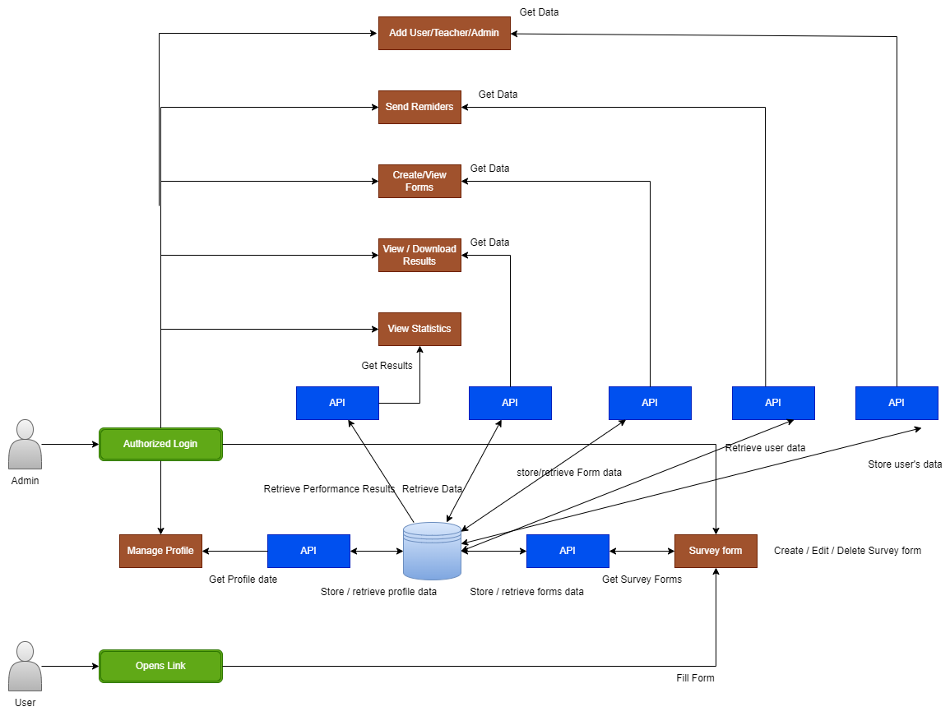
Architecture
MERN Stack
MySQL
Express.js
React.js
Node.js
Chart.js
react-json-to-csv
Node package manager
Notes:
q

Slide 9
Architecture
Notes:
q

Slide 10
Remaining Work
Next aim towards our project is to:
Deploy it using Vercel and Glitch
Notes:
q

Slide 11
References
[1] Anthology. https://www.campuslabs.com/campus-labs-platform/ improvement-and-accountability/studies-and-instruments/ last accessed October 10, 2023
[2] Google forms. https://www.google.com/forms/about/ last accessed October 10, 2023
[3] Survey monkey. https://www.surveymonkey.com/ last accessed October 10, 2023
[4] Metrics for learning. https://www.metricsforlearning.com/ last accessed October 10, 2023
[5] Qualtrics. https://www.qualtrics.com/ last accessed October 10, 2023
[6] Json to csv. https://www.npmjs.com/package/react-json-to-csv last accessed November 10, 2023
[7] React hooks. https://legacy.reactjs.org/docs/hooks-overview.html last accessed November 12, 2023

